Slide 1
POSTMAN
… as an integration test platform

Slide 2
WEB APIs are simple
Web APIs are at the frontier between client and server
Web APIs are based on simple HTTP principles
Web APIs should be testable by people who do not use Visual Studio.
Web APIs testers are HTTP clients
Web APIs need a fast, simple and client-oriented testing workflow

Slide 3
SPECFLOWs are not
Specflow tests are not easily accessible by a front-end developer working on a macbook
Specflow tests use a C# api client leveraging the full .NET environment overhead for sending simple HTTP requests
Specflow .feature files create a useless functional abstraction implying both C# devs and JS devs implement a client
Visual Studio won’t let each dev create personal sets of tests
You can’t quickly use specflows to test a distant environment

Slide 4

But there’s POSTMAN !
Postman is easy to install and use on any computer
Postman does HTTP requests out of the box !
Postman offers lightweight shareable JSON collections of tests that could represent features
Postman has a dedicated UI
Postman provides a javascript environment to test the API results
Postman can use chrome cookies for a given domain
Postman can be automated with Newman
Postman provides environment switching

Slide 5
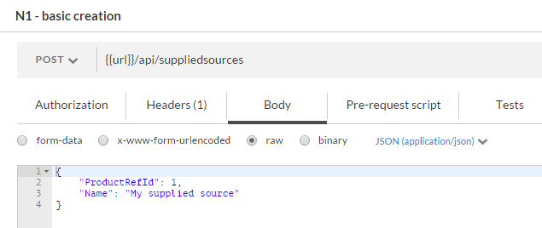
Using Postman
I want to create a source on the graph.
Given a productref { id = 1, name = ‘tomato’ } is in the repository (previous import)
Given the supplied source contract is documented

Slide 6
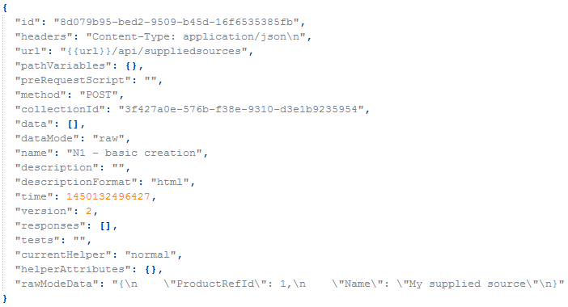
Using Postman
A request is just json data :

